Slide 1

Maine Workers’ Compensation Board
Medical Fee Schedule Training For Providers

Slide 2

Acronyms
EE – employee
ER – employer
DOI – date of injury
IR – insurer
MFS – medical fee schedule
TPA – third party administrator
WC – workers’ compensation
WCB – Workers’ Compensation Board

Slide 3
Headlines
New Governor
New Workers’ Compensation Board Executive Director
New Board Rules Chapter 5, aka MFS Effective 9-1-18
New Rates Effective 1-1-19

Slide 4
MFS Effective 9-1-18
Submission of bills:
Bills for insured employers must be submitted directly to the insurer of record on the date of injury/illness.
Health care providers shall attempt to verify the name of the insurer that wrote the workers’ compensation policy for the specific employer on the date of injury/illness prior to the submission of a bill to an insurer.

Slide 5
MFS Effective 9-1-18
Denied claims:
In cases where the underlying injury has been controverted or denied, a copy of the notice of controversy must be sent to each health care provider that submits or has submitted a request for payment within 30 days of receipt.

Slide 6
MFS Effective 9-1-18
Multiple procedure rule:
-51 Multiple Procedures: the total reimbursement for all services is the maximum allowable payment under this chapter for the primary procedure in addition to 50% for the secondary procedure, 25% for the tertiary procedure and 10% for each lesser procedure thereafter pay the highest weighted procedure at 100% of the maximum allowable payment under this chapter and all additional procedures at 50% of the maximum allowable payment under this chapter.

Slide 7
MFS Effective 9-1-18
Health care records accompanying the bill:
Health care providers may charge for copies of the health care records required to accompany the bill. The charge is to be identified on the bill using CPT® Code S9981 (units equal total number of pages). The maximum fee for copies is $5 for the first page and 45¢ for each additional page, up to a maximum of $250.00.

Slide 8
MFS Effective 9-1-18
Medical release forms:
All parties, including health care providers, shall only use Form WCB-220, WCB-220A, WCB-220B, or WCB-220C set forth in Appendix V. The use of forms other than the ones set forth in Appendix V and/or requiring additional forms is prohibited.

Slide 9
MFS Effective 9-1-18
Diagnostic Medical Report, aka M-1 form:
Health care providers must complete the M-1 form set forth in Appendix I in accordance with Title 39-A M.R.S.A. § 208. The use of a form other than the one set forth in Appendix I is prohibited and may subject the health care provider to penalty under 39-A M.R.S.A. § 360.

Slide 10
MFS Effective 9-1-18
Definition of new patient:
A. CPT definition
B. A new patient is one who is being evaluated for a new injury/illness to determine work relatedness/causality, or
C. A new patient is one who is being seen for a new episode of care for an existing injury/illness.

Slide 11
MFS Effective 9-1-18
Anesthesia billing:
Time Unit: Health care providers must bill time units only the number of minutes of anesthesia time.

Slide 12
Increased Rates
Effective 1-1-19
Professional Fees
Facility Fees
Anesthesia - $60
All Other Professional - $60
DMEPOS – 135% of Medicare
IP ACH - $11,121.68
IP CAH - $11,788.98
OP ACH - $150.05
OP CAH - $174
OP ASC - $113.39

Slide 13
Statutory and Regulatory References
39-A M.R.S.A. § 205(4)
  Board Rules Chapter 15
39-A M.R.S.A. § 206
39-A M.R.S.A. § 208

Slide 14
Statutory and Regulatory References
39-A M.R.S.A. § 209-A
  Board Rules Chapter 5, aka Medical Fee Schedule
39-A M.R.S.A. § 222
  Bureau of Insurance Rules Chapter 530
39-A M.R.S.A § 306

Slide 15

Rights of Parties as to Medical and Other Services: Act § 206
An employee sustaining a personal injury arising out of and in the course of employment or disabled by occupational disease …

Slide 16
Rights of Parties as to Medical and Other Services: Act § 206
… is entitled to reasonable and proper medical, surgical and hospital services, nursing, medicines, and mechanical, surgical aids, as needed, paid for by the employer.

Slide 17
Rights of Parties as to Medical and Other Services: Act § 206
The employer initially has the right to select for the employee a health care provider authorized to practice as such under the laws of the State.
After 10 days from the inception of health care, the employee may select a different health care provider.

Slide 18

Employee Not Liable:
Act § 206(13)
An employee is generally not liable for any portion of the cost of any provided medical or health care services related to a work-related injury or illness.

Slide 19
Provisional Medical Payments:
Act § 222
Payment of benefits due a person under an insured disability plan or insured medical payments plan may not be delayed or refused because that person has filed a workers' compensation claim based on the same personal injury or disease.

Slide 20
Statutory and Regulatory References
There are no statutory or regulatory provisions regarding:
“Timely Filing”
NCCI/OCE Edits and Other Medicare Payment Policies and Reimbursement Rules
Explanation of Benefits/Review
Appeals/Requests for Reconsideration

Slide 21
Patient Registration
Patient Encounter
M-1 Form to EE/ER within 5 days
Billing
Health care records must also be sent with the bills
Reimbursement
Provider Review
Appeal/Request for Reconsideration
Provider Petition

Slide 22
Medical Fee Schedule:
Act § 209-A
  In order to ensure appropriate limitations on the cost of health care services while maintaining broad access for employees to health care providers in the State, the board shall adopt rules that establish a medical fee schedule setting the fees for medical and ancillary services and products rendered by individual health care practitioners and health care facilities.

Slide 23

Board Rules Chapter 5 aka Maine WC MFS
Outlines billing procedures and reimbursement levels for health care providers who treat injured employees.
Describes the dispute resolution process when there is a dispute regarding reimbursement and/or appropriateness of care.
Sets standards for health care reporting.

Slide 24
Patient Registration
Patient Encounter
M-1 Form to EE/ER within 5 days
Billing
Health care records must also be sent with the bills
Reimbursement
Provider Review
Appeal/Request for Reconsideration
Provider Petition

Slide 25
Patient Registration
“Patient was working in a contracting job this morning, was using a nail gun to put a nail through a piece of wall. A nail unexpectedly ricocheted off a board behind the wall, came back through the wood in a curved fashion and pierced his left thumb.”

Slide 26
Patient Registration
Is the patient an employee or independent contractor?
Is the patient an owner or family member of the owner of the company/employer (waiver)?
Assuming the patient is an employee, does the patient have the right to refuse to file a worker’s compensation claim?

Slide 27
Patient Registration
“The patient states that he does a lot of standing for his job. He lifted his right leg 2 days ago while working. He immediately experienced some right calf pain.”

Slide 28
Patient Registration
Is the patient claiming he/she sustained a personal injury arising out of and in the course of employment?

Slide 29
Patient Registration
“This 24-year old male presents here with his mom. For the past 2 days he has experienced left-sided sharp chest pain exacerbated with deep breathing and torso movements. …The patient can recall no specific injury however the day before he had an extremely busy shift while working at a local restaurant kitchen.”

Slide 30
Patient Registration
This patient is stating he can recall no specific injury, should this be registered as workers’ compensation?

Slide 31
Patient Registration:
Medicare Set Asides
A WCMSA allocates a portion of a workers’ compensation settlement for all future work-injury-related medical expenses that are covered and otherwise reimbursable by Medicare.

Slide 32
Patient Registration:
Medicare Set Asides
Best practice is to establish a separate financial class for employees with a WCMSA to facilitate the billing/payment process.
  If you mistakenly bill Medicare or other insurer for treatment related to the work injury, you are responsible for refunding any payments received for that treatment.

Slide 33
Patient Registration: M-1 Form
HEADER INFORMATION ON THE M-1 DIAGNOSTIC MEDICAL REPORT
  EMPLOYEE NAME:
  EMPLOYEE SSN (last 4 digits only):
  EMPLOYEE DOB:
  EMPLOYEE PHONE:
  EMPLOYER NAME:
  EMPLOYER ADDRESS:
  DATE OF INJURY:
  TIME OF INJURY:
  DID INJURY OCCUR ON EMPLOYER PREMISES? IF NO, LIST PLACE OF INJURY
  SUPERVISOR’S NAME
  SUPERVISOR’S PHONE:
  EMPLOYER FAX:
  NATURE/CAUSE OF INJURY:

Slide 34
Patient Registration: M-1 Form
Capture the employee/patient name, SSN, DOB, and phone number.

Slide 35
Patient Registration: M-1 Form
Capture the name, address, and fax number of the employer of injury.
  This may or may not be the patient’s current employer.

Slide 36
Patient Registration: M-1 Form
Capture the date, time and location of the injury.
  This may or may not be the address of the employer.

Slide 37
Patient Registration: M-1 Form
Capture the name and phone number of the employee’s supervisor.

Slide 38
Patient Registration: M-1 Form
Capture the nature/cause of the employee/patient’s work-related injury or illness.
  Use words, not diagnosis codes!

Slide 39
Patient Registration
Patient Encounter
M-1 Form to EE/ER within 5 days
Billing
Health care records must also be sent with the bills
Reimbursement
Provider Review
Appeal/Request for Reconsideration
Provider Petition

Slide 40
Authorization:
MFS Section 1.05
Nothing in the Act or these rules requires the authorization of medical, surgical and hospital services, nursing, medicines, and mechanical, surgical aids provided pursuant to 39­-A M.R.S.A. § 206.
  The patient directs his/her own care after the first 10 days. Do not hold off on treatment for pre-authorization as pre-authorization is not a guarantee of payment.

Slide 41
Medical Information:
Act § 208(2)
Duties of Healthcare providers/M-1 Form Requirements
  Initial – to ER and EE within 5 days of examination
  Ongoing – every 30 days
  Final – within 5 days of discharge

Slide 42
Patient Encounter: M-1 Form
Must use the prescribed form – there is a new M-1 Form effective 9/1/18.
  May be subject to fines if not using the prescribed form.
Notes:
$500 per instance for initial
$100 per form
$10,000 willful violation

Slide 43
Patient Encounter: M-1 Form
Except for the header information, the remainder of the M-1 form must be completed by the health care provider.
Make sure the M-1 form is complete.
  A properly completed M-1 form provides notice to the employer.

Slide 44
Patient Encounter: M-1 Form
The initial M-1 form must be provided to the employee and the employer within 5 days of the initial examination.
  Do not send the employer copy with the employee for him/her to deliver.
  Best practice is to contact the employer and confirm the patient employment relationship and then fax the form.

Slide 45
Medical Information:
Act § 208(1)
Certificate of Authorization
  Authorization from the employee for release of medical information by health care providers to the employer is not required if the information pertains to treatment of an injury or disease that is claimed to be compensable under this Act.

Slide 46
Patient Encounter: Health Care Records
Current problem list
Past medical history
  Alcohol abuse
  Major depression
  Post-traumatic stress disorder
  Mental disorder
Social history
  Alcohol
  Drug use
  Hobbies
Family medical history

Slide 47
Patient Registration
Patient Encounter
M-1 Form to EE/ER within 5 days
Billing
Health care records must also be sent with the bills
Reimbursement
Provider Review
Appeal/Request for Reconsideration
Provider Petition

Slide 48
Billing: Timely Filing
There are no “timely filing” requirements for Workers’ Compensation.
  An employer/insurer cannot put a time limit on the submission of workers’ compensation bills. The time for filing petitions is governed by 39-­A M.R.S.A. § 306.

Slide 49
Billing: MFS Section 1.06(1)
Bills must specify the billing entity’s tax identification number; the license number, registration number, certificate number, or National Provider Identifier of the health care provider; the employer; the employee; the date of injury/occurrence; the date of service; the work-related injury or disease treated; the appropriate procedure code(s) for the work-related injury or disease treated; and the charges for each procedure code.

Slide 50
Billing: MFS Section 1.06(1)
Bills properly submitted on standardized claim forms prescribed by the Centers for Medicare & Medicaid are sufficient to comply with this requirement.
  Properly means in accordance with the directions. Make sure you have a copy of the official form directions.
Uncoded bills may be returned for coding.

Slide 51
Billing: MFS Section 1.06(2)
Bills for insured employers must be submitted directly to the insurer of record on the date of injury/illness.

Slide 52
Billing: Insured Employers
Unless the employer is self-insured through the Maine Bureau of Insurance, employers are not allowed to pay WC medical bills directly.
  The carrier is responsible from the first dollar regardless of any deductible.

Slide 53
Billing:
MFS Section 1.07(1)
In general, health care providers may charge the patient directly only for the treatment of conditions that are unrelated to the compensable injury or disease. See 39­A M.R.S.A. § 206(13).

Slide 54
Billing:
MFS Section 1.07(1)
Health care providers may charge the patient directly only for the treatment of conditions that are unrelated to the compensable injury or disease. See 39­A M.R.S.A. §206(13).
  Best practice is to create completely separate encounters when the patient is receiving treatment for a work-injury and other conditions.

Slide 55
Billing: MFS Sections 3.01 and 4.01
Bills for inpatient services must be submitted on a CMS Uniform Billing (UB-04) form. Health care providers are not required to provide the MS-DRG. Inpatient bills without the MS-DRG do not constitute uncoded bills.
Bills for hospital outpatient and ambulatory surgical services must be submitted on a UB-04 form. Outpatient hospital facility services performed on the same day for the same patient must be reported on a single UB-04 form.

Slide 56
Billing: Billing Forms
There is no prescribed billing form for professional services.
  A HCFA-1500 is preferred by claim administrators but not required.

Slide 57
Billing: Medicare Set Asides
If a health care provider is treating an employee for a work injury and that employee has a WCMSA based on the Maine WC MFS, the provider must bill the employee directly using the billing procedures outlined in Board Rules Chapter 5.
  This means you must bill with all the required billing elements, e.g. procedure codes.

Slide 58
Billing: Health Care Records
Health care records must be sent with the bill to substantiate the services. This includes the M-1 form (if applicable).
  Charges for the records must be on the billing form and not a separate invoice.

Slide 59
Billing: Health Care Records
If you do not have a release from the patient, information unrelated to the claimed injury must be redacted from the record/claim forms.
  Best practice is to have a record for WC patients that does not include information unrelated to the claimed injury.

Slide 60
Billing: M-1 Form
Make sure the M-1 form is complete.
  Make sure you are not charging for incomplete forms.

Slide 61
Billing: Confirming Coverage
Use the employer information on the M-1 form to determine coverage/claim administrator information.

Slide 62
Billing: Confirming Coverage
Check the Board’s self-insured list on the website FIRST.
      Some self-insured employers also have excess insurance policies.

Slide 63
Billing: Confirming Coverage
If the employer is not self-insured, use the Employer Insurance Coverage Search.
      Coverage is confirmed only if you find the ER address listed on the policy.

Slide 64
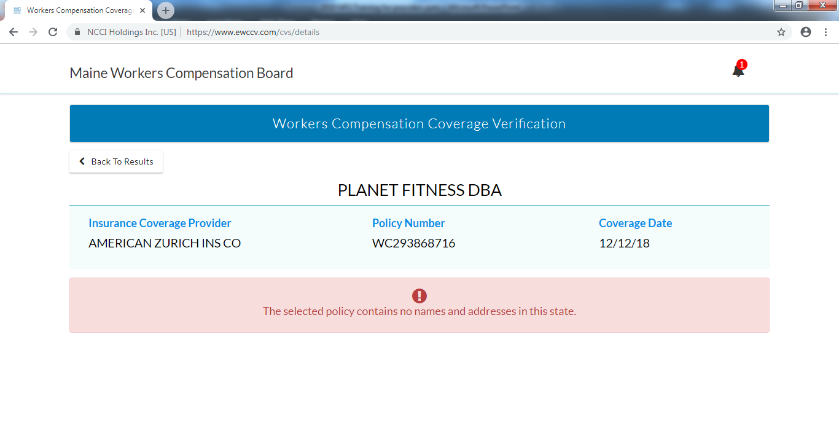
Billing: Confirming Coverage

Slide 65
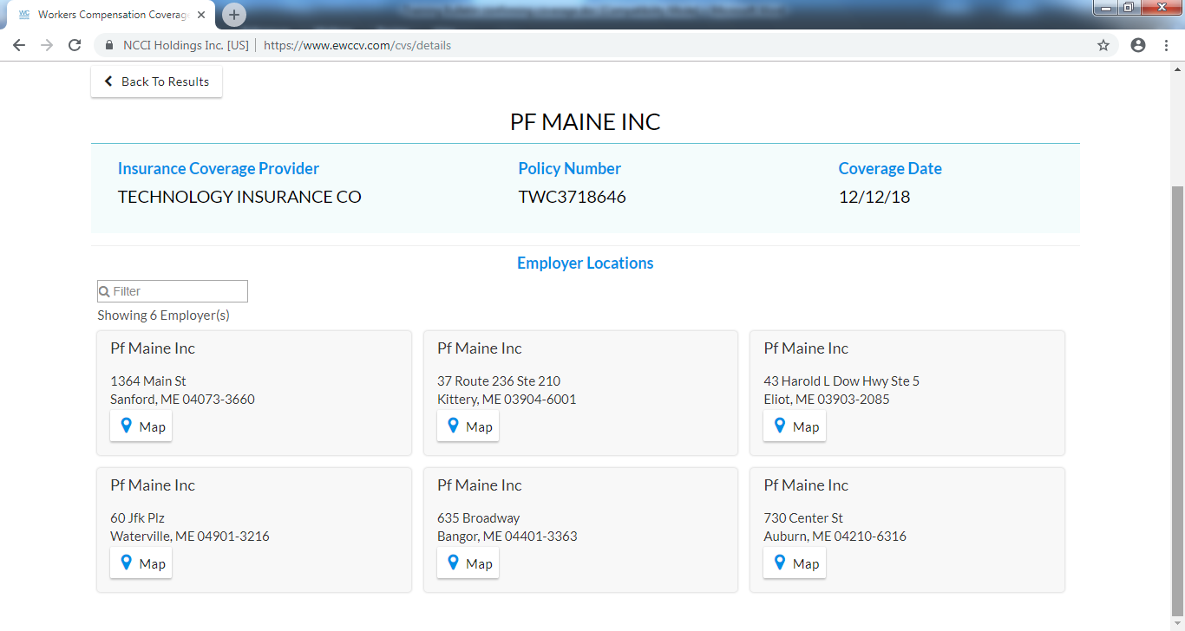
Billing: Confirming Coverage

Slide 66
Billing: Confirming Coverage
If you cannot confirm coverage, contact the Board.

Slide 67
Billing: Insurance Groups
The Insurance Coverage Verification Tool provides the name of the insurance underwriting company; most underwriting companies are part of an insurance group.

Slide 68
Billing: Insurance Groups
Group Number | Group Name | License Number | NAIC | FullName
12 | AMERICAN INTL GRP | 367 | 19380 | AMERICAN HOME ASSURANCE COMPANY
12 | AMERICAN INTL GRP | 308 | 19399 | AIU INSURANCE COMPANY
12 | AMERICAN INTL GRP | 393 | 19402 | AIG PROPERTY CASUALTY COMPANY
12 | AMERICAN INTL GRP | 413 | 19410 | COMMERCE AND INDUSTRY INSURANCE COMPANY
12 | AMERICAN INTL GRP | 482 | 19429 | INSURANCE COMPANY OF THE STATE OF PENNSYLVANIA
12 | AMERICAN INTL GRP | 527 | 19445 | NATIONAL UNION FIRE INSURANCE COMPANY OF PITTSBURGH PA
12 | AMERICAN INTL GRP | 452 | 23809 | GRANITE STATE INSURANCE COMPANY
12 | AMERICAN INTL GRP | 53254 | 23817 | ILLINOIS NATIONAL INSURANCE COMPANY
12 | AMERICAN INTL GRP | 531 | 23841 | NEW HAMPSHIRE INSURANCE COMPANY

Slide 69
Billing: Third Party Administrators
Contractual arrangement with the insurer or self-insurer to administer its claims.
A TPA is generally chosen by the employer so there is not always a one to one relationship, e.g. not all ACE claims are handled by ESIS.

Slide 70
Billing: Third Party Administrators
The Board’s website will not identify if the claim is being handled by a TPA.
Contact the Self-Insurer/Insurer or the Board if you are unsure if there is a third party handling the claims.

Slide 71
Billing: Other Third Parties
Some claim administrators use other third parties to process medical bills, e.g. Corvel.

Slide 72
Billing: Confirm Mailing Address
Confirm the mailing address where medical bills should be sent BEFORE mailing bills/records.
The self-insured employer or insurer is still ultimately responsible so you may legally send the bills/records to the ER/IR even if there is one or more third party involved in handling the claim.

Slide 73

Billing: Scenario 1
Employee Claim | Medical Documentation
Work-Related | Work-Related
Bill To: ER/IR/TPA

Slide 74
Billing: Scenario 2
Employee Claim | Medical Documentation
Work-Related | Not Work-Related or Not Yet Determined
Bill To: ER/IR/TPA

Slide 75
Billing: Scenario 3
Employee Claim | Medical Documentation
Not Work-Related | Work-Related
Bill To: Employee

Slide 76
Billing: Scenario 4
Employee Claim | Medical Documentation
Not Work-Related | Not Work-Related
Not WC

Slide 77
Billing:
Notice of a Claim
Lewis Wilson v. Central Maine Towing, Inc. and The Phoenix Insurance Co.
  If a bill for medical services is received and accompanied by an M-1 and/or other medical information that identifies the time, place, cause and nature of the injury, the employer may be deemed to have knowledge of the injury.

Slide 78
Billing:
Notice of a Claim
Bills for covered employers are not supposed to be returned to the provider just because the employer has failed to report the claim.

Slide 79
Patient Registration
Patient Encounter
M-1 Form to EE/ER within 5 days
Billing
Health care records must also be sent with the bills
Reimbursement
Provider Review
Appeal/Request for Reconsideration
Provider Petition

Slide 80
Reimbursement:
Medicare Set Asides
Employees with a WCMSA based on the Maine WC MFS are required to pay for treatment related to the work injury pursuant to the Maine WC MFS.

Slide 81
Reimbursement:
U&C or MAP
The employer/insurer must pay the health care provider's usual and customary charge or the maximum allowable payment under this chapter, whichever is less, …

Slide 82
Reimbursement: Usual and Customary Charge
Leanne Fernald v. Shaw’s Supermarkets, Inc. and William J. Babine v. Bath Iron Works
    Usual and customary charge is defined as the charge on the price list for the medical service that is maintained by the provider.

Slide 83
Reimbursement: Maximum Allowable Payment (MAP)
The sum of all fees for medical, surgical and hospital services, nursing, medicines, and mechanical, surgical aids established by the Board pursuant to Chapter 5.

Slide 84
Reimbursement:
MFS Section 1.07(2)
The employer/insurer must pay …, within 30 days of receipt of a properly coded bill unless the bill or previous bills from the same health care provider have been controverted or denied.

Slide 85
Reimbursement:
MFS Section 1.07(2)
Changes to bills are not allowed. When there is a dispute, the employer/insurer must pay the undisputed amounts, if any, and file a notice of controversy.
A copy of the denial/NOC Form must be sent to the health care provider from whom the bill originated.

Slide 86
Reimbursement:
MFS Section 1.07(2)
In cases where the underlying injury has been controverted or denied, a copy of the notice of controversy must be sent to each health care provider that submits or has submitted a request for payment within 30 days of receipt.
A health care provider, employee or other interested party is entitled to file a petition.

Slide 87
Reimbursement:
MFS Section 1.07(5)
A written payment agreement directly between a health care provider and an ER/IR supersedes the maximum allowable payment otherwise available under the MFS.
Notes:
5. Nothing in this chapter precludes payment agreements to promote the quality of care and/or the reduction of health care costs.
A. A written payment agreement directly between a health care provider and an employer/insurer supersedes the maximum allowable payment otherwise available under this chapter.
B. A written payment agreement between a health care provider and an entity other than the employer/insurer seeking to invoke its terms supersedes the maximum allowable payment otherwise available under this chapter only if the employer/insurer is a contractual beneficiary of the payment agreement on the date of service.
C. An employee retains the right to select health care providers for the treatment of an injury or disease for which compensation is claimed regardless of any such payment agreement.
D. An employer/insurer that invokes a payment agreement to pay an amount that is different from the maximum allowable payment otherwise available under this chapter shall reference that payment agreement in the employer/insurer’s explanation of payment or benefit.
E. In the event of a dispute as to whether there is a payment agreement that supersedes the maximum allowable payment otherwise payable, the burden is on the party invoking the payment agreement to provide a written contract between the provider and the network within 30 days of a provider’s request. This contract must establish the party’s right to pay an amount different than provided in this chapter. Failure to produce the contract within 30 days of a request will result in the bill being subject to the maximum allowable payment established in this chapter.

Slide 88
Reimbursement:
MFS Section 1.07(5)
A written payment agreement between a health care provider and an entity other than the ER/IR seeking to invoke its terms supersedes the maximum allowable payment otherwise available under the MFS only if the ER/IR is a contractual beneficiary of the payment agreement on the date of service.
Notes:
5. Nothing in this chapter precludes payment agreements to promote the quality of care and/or the reduction of health care costs.
A. A written payment agreement directly between a health care provider and an employer/insurer supersedes the maximum allowable payment otherwise available under this chapter.
B. A written payment agreement between a health care provider and an entity other than the employer/insurer seeking to invoke its terms supersedes the maximum allowable payment otherwise available under this chapter only if the employer/insurer is a contractual beneficiary of the payment agreement on the date of service.
C. An employee retains the right to select health care providers for the treatment of an injury or disease for which compensation is claimed regardless of any such payment agreement.
D. An employer/insurer that invokes a payment agreement to pay an amount that is different from the maximum allowable payment otherwise available under this chapter shall reference that payment agreement in the employer/insurer’s explanation of payment or benefit.
E. In the event of a dispute as to whether there is a payment agreement that supersedes the maximum allowable payment otherwise payable, the burden is on the party invoking the payment agreement to provide a written contract between the provider and the network within 30 days of a provider’s request. This contract must establish the party’s right to pay an amount different than provided in this chapter. Failure to produce the contract within 30 days of a request will result in the bill being subject to the maximum allowable payment established in this chapter.

Slide 89
Patient Registration
Patient Encounter
M-1 Form to EE/ER within 5 days
Billing
Health care records must also be sent with the bills
Reimbursement
Provider Review
Appeal/Request for Reconsideration
Provider Petition

Slide 90

Provider Review: Jurisdiction
You may be treating patients with WC claims that do not fall under the Act. Jurisdiction is based on a variety of factors and not based on where the provider is located (concurrent jurisdiction may exist).
  Federal employees
  Long Shore and Jones Act claims
  Other states/Countries

Slide 91
Provisional Medical Payments:
Act § 222
If you receive a denial/NOC Form in response to the submission of one or more medical bills, you can legally submit the bills to the patient’s health insurance carrier (if any) or to the patient (if none). See Bureau of Insurance Rules Chapter 530.

Slide 92
Provider Review: Overpayments
Workers’ Compensation Board Decision No.96-0:Donald C. Pritchard, Jr. v. S.D. Warren Company and Sedgwick James of Northern New England
The present Act provides this employer with no mechanism to recover what the employer regards as an overpayment of compensation.

Slide 93
Statute of Limitations:
Act § 306
Except as provided in this section, a petition brought under this Act is barred unless filed within 2 years after the date of injury or the date the employee's employer files a required first report of injury if required in section 303, whichever is later.
    This means that you have only 2 years to file a petition on a medical only claim.

Slide 94
Provider Review: Outstanding Bills
Options (one or more) :
  Send notice of nonpayment via certified mail.
  File a Complaint for Penalties (if original billing was sent via certified mail).
  File a Provider’s Petition for Payment of Medical and Related Services (WCB-190A).
  Contact the Office of Medical/Rehabilitation Services (i.e. me) via email.

Slide 95
Statute of Limitations:
Act § 306
If an employer or insurer pays benefits under this Act, with or without prejudice, within the period provided in subsection 1, the period during which an employee or other interested party must file a petition is 6 years from the date of the most recent payment.
  This means you have 6 years to file a petition on an underpayment.

Slide 96

Provider Review: Balance Due
Options (one or more) :
  File an appeal /request for reconsideration with the payor.
  File a Complaint for Penalties (if original billing was sent via certified mail).
  File a Provider’s Petition for Payment of Medical and Related Services (WCB-190A).
  Contact the Office of Medical/Rehabilitation Services (i.e. me) via email.

Slide 97
Provider Review: Appeal/Request for Reconsideration
  There is no requirement for a provider to file an appeal and/or request for reconsideration with the payor before filing a petition with the Maine Workers’ Compensation Board. A health care provider, employee or other interested party is entitled to file a petition for payment of medical and related services for determination of any dispute regarding the provision of medical services. The time for filing petitions is governed by 39-A M.R.S.A. § 306.

Slide 98
Payment of bills for medical or health care services: Act § 205(4)
When there is no ongoing dispute, if bills for medical or health care services are not paid within 30 days after the carrier has received notice of nonpayment by certified mail from the provider … , $50 or the amount of the bill due, whichever is less, must be added and paid for each day over 30 days ...Not more than $1,500 in total may be added.

Slide 99

Board Forms
http://maine.gov/wcb/forms/index.html:
WCB-190A | Provider's Petition for Payment of Medical and Related Services
WCB-410 | Complaint for Penalties Pursuant to 39-A § 205(4)
WCB-282 | Complaint for Audit

Slide 100
Board Forms
WCB-190A
WCB-410
Three other parties to the petition (EE, ER, IR)
You must attend mediation and possible hearing if claim is not resolved at Troubleshooting
You could lose the case on behalf of the employee so make sure your documentation supports a work-injury
The only other party to the petition is the IR
You must have sent the claim via certified mail (you must provide separate notice for each DOS to receive separate penalties)
You must provide a position paper upon request

Slide 101
Complaint for Penalties: Form 410
A Complaint for Penalties under 39-A § 205(4) is for bills that were sent in accordance with Board rules via certified mail. You could potentially receive payments for any unpaid or underpaid bills not paid or denied within 30 days receipt.

Slide 102
Complaint for Penalties: Form 410
This is a request for penalties only but often has the result of facilitating payment of the claim also.
Make sure you respond to the Board’s request for a position paper or your complaint will be dismissed!

Slide 103
Complaint for Penalties: Form 410
On (insert date of injury), (insert employee/patient name) sustained a work-related injury while working for (insert employer/insured name).

Slide 104

Complaint for Penalties: Form 410
On (insert date the notice of non-payment was sent via certified mail), the health care provider sent the employer/insurer copies of bills for medical or health care services related to the work-related injury.

Slide 105
Complaint for Penalties: Form 410
FILING INSTRUCTIONS :
  1. Mail original complaint to the WCB at the above address by regular mail.
  2. Mail one (1) copy by certified mail, return receipt requested, to each other party named in the complaint.
  3. Keep one (1) copy for yourself and keep the green certified mail cards when returned to you by the U.S. Post Office.

Slide 106
Complaint for Penalties: Form 410
Complaint will be processed in accordance with Board Rules Chapter 15.
You will be asked to provide a position paper; make sure you respond or your complaint will be dismissed.
Hearing Officer Dunn will issue an order regarding the disposition of the complaint.

Slide 107
Provider’s Petition for Payment:
Form 190-A
On (insert date of injury), (insert employee/patient name) sustained a work-related injury while working for (insert employer/insured name).

Slide 108
Provider’s Petition for Payment:
Form 190-A
The treatment included (describe the treatment provided) for the employee’s injured.

Slide 109
Provider’s Petition for Payment:
Form 190-A
FILING INSTRUCTIONS:
  1. Mail original petition to the WCB at the above address by regular mail.
  2. Mail one (1) copy by certified mail, return receipt requested, to each other party named in the petition.
  3. Keep one (1) copy for yourself and keep the green certified mail cards when returned to you by the U.S. Post Office.

Slide 110
Provider’s Petition for Payment:
Form 190-A
Three (3) Tiers of Dispute Resolution
  Claims Resolution Specialists (a.k.a.Troubleshooters)
  Mediation
  Hearing
Five (5) Regional Offices
  Augusta, Bangor, Caribou, Lewiston, Portland

Slide 111
Complaint for Audit:
Form 282
The Complainant asks the Board to conduct an investigation to determine if the insurer, self-administered employer or third-party administrator has violated 39-A M.R.S.A. Section 359 by engaging in a pattern of questionable claims-handling techniques or repeated unreasonably contested claims and/or has violated Section 360(2) by committing a willful violation of the Act or committing fraud or intentional misrepresentation. The Complainant asks that the Board assess all applicable penalties.

Slide 112
Complaint for Audit:
Form 282
Can be filed on one or several claims.
Sent to the Board’s Director of Audits Gordon.Davis@maine.gov

Slide 113
Provider Review: Top Reasons Bills are Paid Incorrectly
Procedures with modifiers not paid correctly
Outpatient facility bills paid by applying the “lessor-of” logic at the line level versus the bill level
Implants, medical records charges, and/or the charge to complete the M-1 form are not paid
Professional fee schedule applied to facility fees; i.e. using Appendix II rather than IV

Slide 114
Provider Review: Top Reasons Bills are Paid Incorrectly
Medicare logic applied versus the Maine WC fee schedule rules
Network discounts applied inappropriately
Facility or professional charges not paid for providers that split bill

Slide 115
Provider Review:
Professional Services
MAP using Section 2 and Appendix II.
  Based on National Physician Fee Schedule Relative Value File and the Board’s base rates.
  Lesser of logic applied line by line.

Slide 116
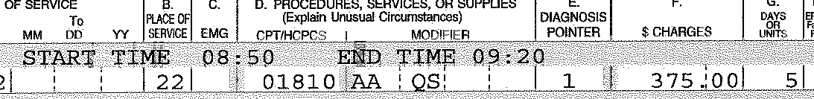
Anesthesia Example
QX
Board Rules and Regulations, Chapter 5:
  Base Unit = 3 per Appendix II
  Time Units = 2 per Section 2.03, Subsection 1.B.
Amount Due:
  3 Base Unit + 2 Time Units = 5 Total Units
  5 Total Units X $60.00 = $300.00
  Modifier QX – pay at 50% = $150.00 (MAP less than U&C charge).
Notes:
Providers are suppose to bill minutes only in box 24G; bill should state 30 units. In this case the quantity 5 represents the combination of the base units (3) and the time units (2) from the time narrative.
QX Surgical Anesthesia: CRNA was medically directed by a physician (2, 3, or 4 concurrent procedures): pay 50% of the maximum allowable payment under this chapter.

Slide 117
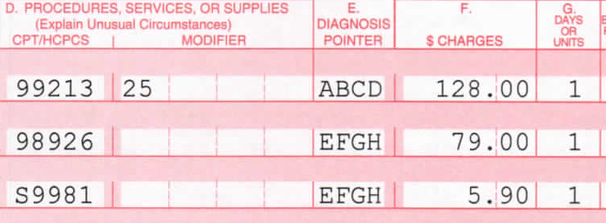
Evaluation & Management Example
Appendix II:
CPT | FEE
99213 | $125.40
98926 | $76.80

Slide 118
Evaluation & Management Example
2018 E&M Example
S9981 is not in Appendix II. Per Section 1.08(3): The maximum fee for copies is $5 for the first page and 45¢ for each additional page, up to a maximum of $250.00.

Slide 119
Evaluation & Management Example
2018 E&M Example
Amount Due = $125.40 + $76.80 + $5.00 = $207.20 (all MAPs less than charges).
  Units for S9981 should have been 3 (total number of pages) but provider didn’t bill correctly.

Slide 120
Evaluation & Management Example #2
2018 E&M Example #2
Appendix II:
CPT | FEE
99203 | $183.00

Slide 121
Evaluation & Management Example #2
2018 E&M Example #2
99080 not in Appendix II. Per Section 1.08(2): The maximum fee for preparing a narrative report or the initial M-1 shall be: Each 10 minutes: $30.00.

Slide 122
Evaluation & Management Example #2
2018 E&M Example #2
Amount Due = $170.00 (charge less than MAP) + $30.00 (charge equals MAP) = $200.00.

Slide 123
Evaluation & Management Example #2
2018 E&M Example #2
What if the employee was seen last month for a different injury; is a new patient visit code allowed?
  Per new MFS Section 2.02, a new patient visit code is allowed for the evaluation of a new injury.

Slide 124
Evaluation & Management Example #2
2018 E&M Example #2
What if the documentation only supports a level 2 new patient visit?
  Per MFS Section 1.07(2)(A), the undisputed charges must be paid and a denial filed with the Board. A copy of the partial denial/NOC Form must be sent to the health care provider.

Slide 125
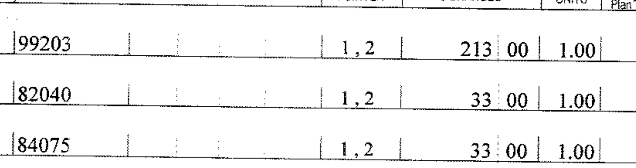
Evaluation & Management Example #3
2018 E&M Example #3
Appendix II:
CPT | FEE
99203 | $183.00

Slide 126
Evaluation & Management Example #3
2018 E&M Example #3
Amount Due:
  82040 and 84075 are valid codes that are not in Appendix II so they default to their usual and customary charge.
  $183.00 (MAP less than U&C charge)+ $33.00 + $33.00 = $249.00.

Slide 127
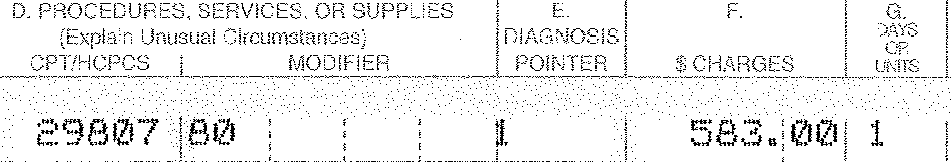
Surgical Example
Appendix II:
CPT | FEE
29807 | $1,792.80

Slide 128
Surgical Example
Modifier 80 Assistant Surgeon: pay 25% of the maximum allowable payment under this chapter.
Amount Due = .25 X $1,792.80 = $448.20 (MAP less than U&C charge).

Slide 129
Surgical Example #2
50
Appendix II:
CPT | FEE
29807 | $1,792,80

Slide 130
Surgical Example #2
50
Modifier 50 Bilateral Procedure: pay 150% of the maximum allowable payment under this chapter for both procedures combined.
Amount Due = $583.00 (U&C charge less than MAP (1.5 X $447.30 or $672.30).

Slide 131
Surgical Example
What if Medicare doesn’t allow assistant surgeons for this particular procedure?
  Per MFS Section 1.02, “The Board has not adopted all components used by the federal Centers for Medicare and Medicaid Services. Therefore, the application of any fee schedule, payment system, claims processing rule, edit or other method of determining the reimbursement level for a service(s) not expressly adopted in this chapter is prohibited.”
    If the ER/IR contends that the assistant was not reasonable/proper, it has to file a denial with the Board and send a copy of the NOC Form to the provider.

Slide 132
Radiology Example
Appendix II:
CPT | MOD | FEE
74178 | 26 | $171.00
73700 | 26 | $85.80

Slide 133
Radiology Example
Code 74020 is a deleted code.
  Per MFS Section 1.07(2)(A), the undisputed charges must be paid and a denial filed with the Board. A copy of the partial denial/NOC Form must be sent to the health care provider.

Slide 134
Radiology Example
Amount Due = $171.00 + $85.80 = $256.80 (MAPs less than U&C charges). Contemporaneously, the ER/IR must file the denial and send a copy of the NOC to the provider.

Slide 135
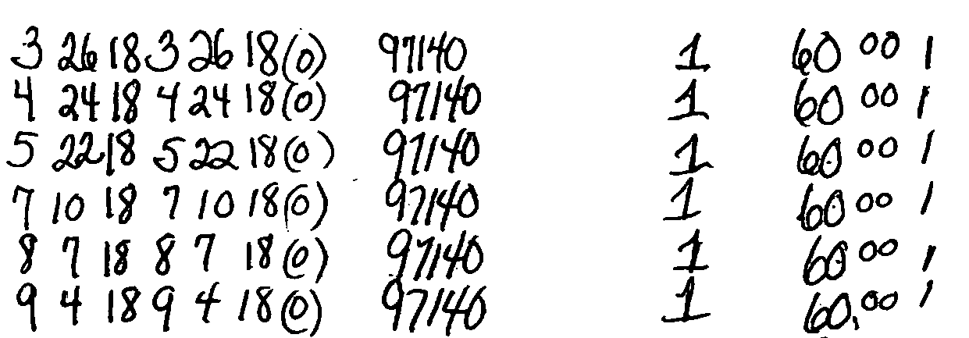
Massage Therapy Example
Code 97140 is defined by the AMA in 15 minute increments.
  Per MFS Section 1.07(2), the ER/IR cannot change a provider’s bill. As billed, this provider will be significantly underpaid if these charges are for 1 hr massage.

Slide 136
Massage Therapy Example
Amount Due = $47.40 per DOS for total of 284.40 (MAPs less than U&C charges). If billed correctly, amount due $360.

Slide 137
DMEPOS Example
Appendix II:
Amount Due = $375.09 (U&C charge less than MAP).
CPT | MOD | MOD2 | FEE
L4360 |  |  | $452.30

Slide 138
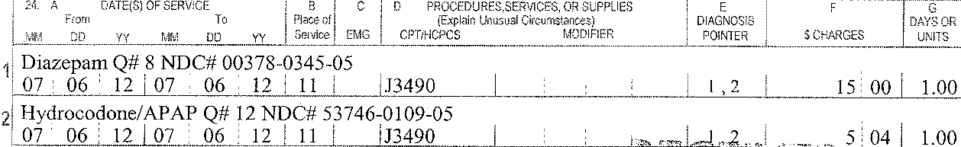
DMEPOS Example #2
Amount Due:
  J3490 is a valid code that is not in Appendix II so it defaults to the usual and customary charge for each drug.
  $15.00 + $5.04 = $20.04.

Slide 139
DMEPOS Example #2
  Can the ER/IR pay a usual and customary fee based on the NDC#?
    No, not unless it has a written payment agreement. If the ER/IR contends that the charges are not reasonable/proper, it has to file a denial with the Board and send a copy of the NOC Form to the provider.

Slide 140
Provider Review: Inpatient Facility Fees
MAP using Section 3 and Appendix III.
  Based on Table 5.—List of Medicare Severity Diagnosis-Related Groups (MS-DRGS) and the Board’s base rates.
  Lesser of logic applied at total claim level.

Slide 141
Provider Review: Inpatient Facility Fees continued
Outliers – threshold is $75,000.00 plus the fee in Appendix III.
Implantables – hospitals may seek additional reimbursement for implantables over $10,000.
  Must submit substantiating invoices. Invoices should be submitted contemporaneously with the bill.
  Professional Services – max fees as outlined in Appendix II.

Slide 142
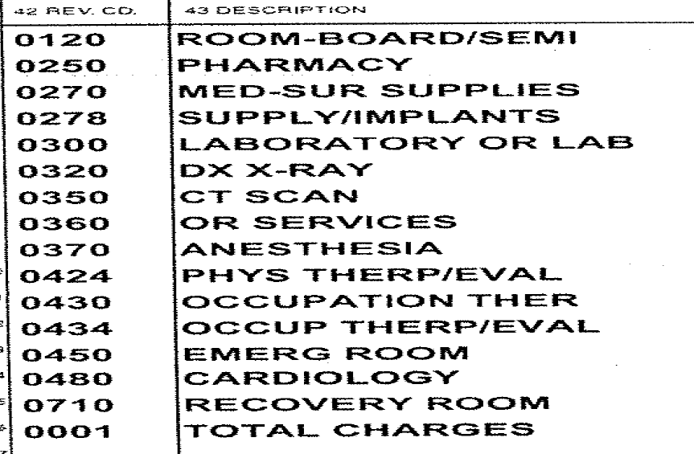
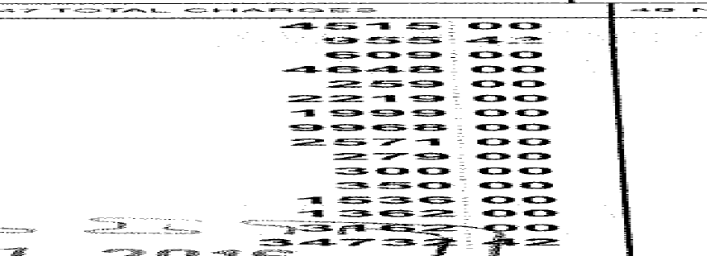
ACH Inpatient Facility Example

Slide 143

ACH Inpatient Facility Example
Appendix III:
MS-DRG | ACH Fee
494 | $19,506.31

Slide 144
ACH Inpatient Facility Example
Outlier
    No outlier payment due (total charges of $34,732.42 less than outlier threshold of $94,506.31).
      Outlier threshold is amount in Appendix III of $19,506.31 plus $75,000.

Slide 145
ACH Inpatient Facility Example
Implantables
    No implantable payments due (total charges for implants is only $4,648.00 so cost is clearly less than $10,000.00).
      In order to be separately reimbursable, implants must cost over $10,000. Remember that the definition of implantable includes “any related equipment necessary to operate, program, and recharge the implantable” so make sure to look at cost in the aggregate.

Slide 146
ACH Inpatient Facility Example
What if the total charges were 134,732.42?
$134,732.42 total billed charges
    - 19,506.31 fee per Appendix III
    - 75,000.00 per Chapter 5, Section 3.06
    $ 40,226.11
    X .75
  $30,169.58 outlier payment

Slide 147
ACH Inpatient Facility Example
Amount due based on $34,732.13 total charges:
$19,506.31 fee per Appendix III
Amount due based on 134,732.42 total charges:
$19,506.31 fee per Appendix III
$30,169.58 outlier payment
    $49,675.89

Slide 148
ACH Inpatient Facility Example
  What if the bill did not have the DRG code on it?
    An inpatient bill that does not include the DRG does NOT qualify as an uncoded bill. The DRG is not a required billing element.

Slide 149
Provider Review: Outpatient Facility Fees
MAP using Section 4 and Appendix IV.
  Based on Addendum B.-Final OPPS Payment by HCPCS Code and the Board’s base rates.
  Lesser of logic applied at total claim level.

Slide 150
Provider Review: Outpatient Facility Fees
Section 4.05 Payment Calculation Subsection 1.
  Procedure codes with no CPT or with status N, no separate payment.

Slide 151
Provider Review: Outpatient Facility Fees
Section 4.05 Payment Calculation Subsection 2.
  If the fee listed in Appendix IV is $0.00 for a code with a status other than N, payment is at 75% of charge.

Slide 152
Provider Review: Outpatient Facility Fees
Section 4.05 Payment Calculation Subsection 3.
  When there are 2 or more status T’s, the highest weighted is paid at 100%, all others at 50%.
  Add-on codes not discounted.

Slide 153
Provider Review: Outpatient Facility Fees
Section 4.05 Payment Calculation Subsection 4.
  When one or more procedure codes with a status indicator of N are billed without other outpatient services, payment must be 75% of the provider’s usual and customary charges.

Slide 154
Provider Review: Outpatient Facility Fees continued
Outliers – threshold is $2,500.00 per procedure code plus the fee in Appendix IV.
Implantables – facilities may seek additional reimbursement for implantables over $250.
  Must submit substantiating invoices. Invoices should be submitted contemporaneously with the bill.
  Professional Services – max fees as outlined in Appendix II.

Slide 155
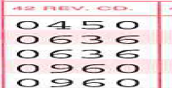
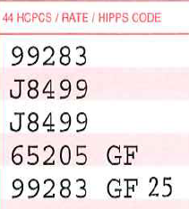
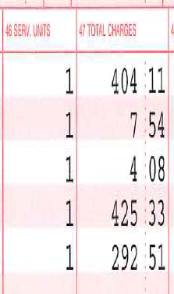
CAH Outpatient Facility Example
What do you notice about this outpatient facility bill? Is there a duplicate charge?

Slide 156
CAH Outpatient Facility Example
  This bill has both facility and professional fees.
  Reminder: Revenue codes in the 96x, 97x and 98x series are professional fees.

Slide 157
CAH Outpatient Facility Example
Do the E/M facility fee level and E/M professional fee level have to match?
  No. The charges do not have to match. For example, the provider service may have been complex but consumed very few facility resources.

Slide 158
CAH Outpatient Facility Example
Appendix IV:
Code | Status | CAH Fee
99283 | J2 | $488.12
J8499 | E1 | $0.00

Slide 159
CAH Outpatient Facility Example
Per MFS Section 4.05(2): If the ACH Fee, CAH Fee or ASC Fee listed in Appendix IV is $0.00 for a procedure code with a status indicator other than N, then payment must be calculated at 75% of the health care provider’s usual and customary charge.

Slide 160
CAH Outpatient Facility Example
Facility fees are evaluated on a total charge basis: $488.12+$8.72 (.75(7.54+4.08)) = $496.84 (more than $415.73 total facility charges).

Slide 161
CAH Outpatient Facility Example
Appendix II:
Code | Mod | ACH Fee
65205 |  | $78.60
99283 |  | $105.00

Slide 162
CAH Outpatient Facility Example
Professional fees are evaluated on a line by line basis: $78.60 (less than $425.33) + $105.00 (less than $292.51) = $183.60.

Slide 163
CAH Outpatient Facility Example
Amount Due:
$415.73 facility fees (total facility charges)
+183.60 professional fees
$599.33

Slide 164
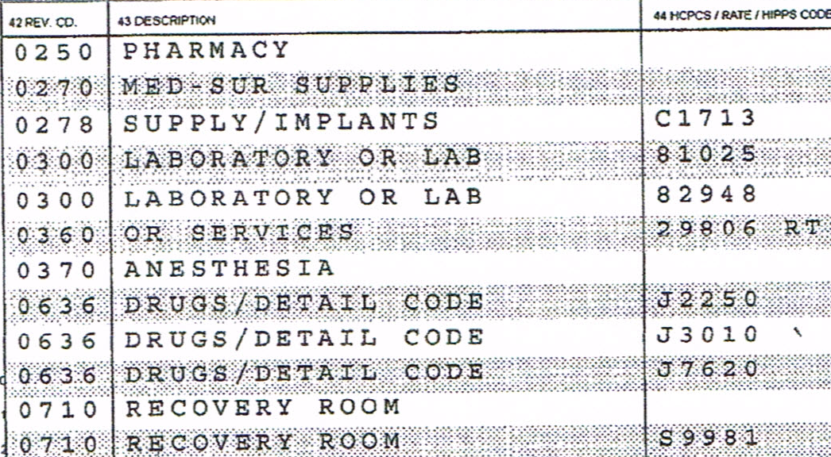
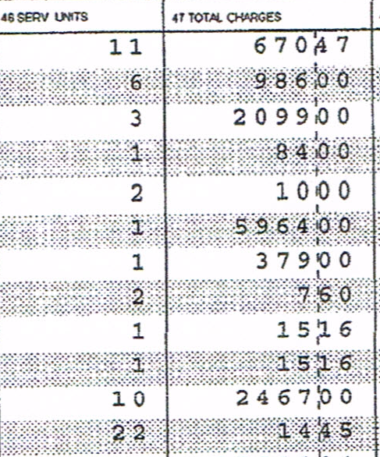
ACH Outpatient Facility Example
Appendix IV:
Code | Status | ACH Fee
C1713 | N | $0.00
81025, 82948 | Q4 | $0.00
29806 | J1 | $10,758.89
Code | Status | ACH Fee
J2250 | N | $0.00
J3010 | N | $0.00
J7620 | M | $0.00

Slide 165
ACH Outpatient Facility Example
Outlier
    No outlier payment due (charges of $5,964.00 less than outlier threshold of $13,258.89).
      Outlier threshold is amount in Appendix IV of $10,758.89 plus $2,500.

Slide 166
ACH Outpatient Facility Example
    Implantables
  $ 1,410.00 cost of 3 units C1713 ($470/each)
  x 1.2 per Chapter 5, Section 4.07
  = $1,692.00

Slide 167
ACH Outpatient Facility Example
Amount due:
  $10,758.89 29806 fee per Appendix IV
  81.87 charges paid at 75% of charge
  $10,840.76 MAP more than total facility charges less implants of $10,612.84 (12,711.84-2,099)
  $10,612.84 facility fees from above
  1,692.00 implantables
  14.45 medical records
  $ 12,304.84

Slide 168
ACH Outpatient Facility Example
What if the charges for procedure code 29806 were 15,964.00?
  $ 15,964.00 charge for procedure 29806
    - 10,758.89 fee per Appendix IV
    - 2,500.00 per Chapter 5, Section 4.06
    2,705.11
    x .75
    = $2,028.83 outlier payment

Slide 169
ACH Outpatient Facility Example
Amount due with outlier:
  $10,840.76 total facility charges were increased by $10,000 making the max fee less than total facility charges less implant charges
  2,028.83 outlier
  1,692.00 implantables
  14.45 medical records
  $ 14,576.04

Slide 170
ACH Outpatient Facility Example
Appendix IV:
Code | Status | ACH Fee
C1713 | N | $0.00
81025, 82948 | Q4 | $0.00
29806 | J1 | $10,758.89
Code | Status | ACH Fee
J2250 | N | $0.00
J3010 | N | $0.00
J7620 | M | $0.00

Slide 171
ACH Outpatient Facility Example
Why isn’t the amount due for the surgical procedure capped at the amount of the operating room charges?
  Charges on the 360 revenue code line represent the charges for the operating room only and the operating room charges are only one component of the procedure. The charges for the procedure are actually spread over several lines, i.e. pharmacy, supplies, anesthesia, recovery room.
    The APC payment is for the whole procedure, not just the operating room costs.

Slide 172
Statutory and Regulatory Links
39-A M.R.S.A.
  http://legislature.maine.gov/statutes/39-A/title39-Ach0sec0.html
Workers’ Compensation Board Rules
  http://maine.gov/wcb/rules.html

Slide 173
Statutory and Regulatory Links
Medical Fee Schedule
  http://maine.gov/wcb/Departments/omrs/medfeesched.html
Bureau of Insurance Rules
  http://www.maine.gov/sos/cec/rules/02/chaps02.htm#031

Slide 174
WCB website: www.maine.gov/wcb
Messages from Executive Director
Board of Directors
  Meeting agendas
  Meeting minutes

Slide 175
WCB website: www.maine.gov/wcb
Proposed Rules
List serves
  Notice of Rulemaking, Board agendas/minutes
  MRS News

Slide 176
WCB website: www.maine.gov/wcb
Medical/Rehab Services
  Medical Fee Schedule
    Annual updates effective Oct. 1 and Jan. 1
    Periodic updates every 3 years
    FAQ
    Training materials

Slide 177
WCB website:
Featured Links
  Insurance Coverage Verification
    List of Authorized Self-Insured Employers
    Access to Coverage Information for Insured Employers

Slide 178
WCB website:
Featured Links
Bureau of Insurance
  License and Contact Information

Slide 179
WCB: Primary Resource
  – Kimberlee.McCarson@maine.gov
  Coverage/claim administrator inquires
  No claim on file
  MFS questions/concerns

Slide 180
WCB: Other Resources
Coverage/Claim Administrator information:
  Sarah.Mare@maine.gov
  Board Troubleshooters (each of the Board’s Regional Offices based on employee zip code)
Copies of Board Forms:
  Sandra.Wade@maine.gov

